Slide 1
The Writing Process and the AP Test
Advanced Placement World History
Mt. Juliet High School
Mr. McGee

Slide 2
Exam Description
The AP World History Exam is 3 hours and 15 minutes long and includes both a 1 hour and 45 minute multiple-choice/short-answer section and a 1 hour and 30 minute free-response section. Each section is divided into two parts, as shown below.
Student performance on these four parts will be compiled and weighted to determine an AP Exam score.
Section 1, Part A: Multiple Choice: 55 Q’s/55 Minutes/40% of exam score
Section 1, Part B: Short Answer Questions (SAQ): 4 Q’s/50 Minutes/20% of exam score
Section 2, Part A: Document-Based Question (DBQ): 1 Question/55 minutes (includes a reading period with a suggested time of 15 minutes)/20% of exam score
Section 2, Part B: Long-Essay Question (LEQ): 1 Question (Chosen from a pair)/35 minutes/15% of exam score

Slide 3
Scoring
1-5 (1 is lowest, 5 is highest)
A 3 is generally considered “passing,” but be sure to check with your college to make sure a 3 is all that is needed!
http://appass.com/calculators/world (Still set up for old exam. I will make post it if and when it gets updated or I find a different one)

Slide 4
Thesis Statement

Slide 5
Getting it Right
States the purpose of your paper
Controls, asserts, and structures your argument
The most difficult sentence to formulate!

Slide 6
State Your Thesis Correctly
Conveys to the reader the points and/or arguments you wish to make
Serves as a road map, giving the direction of the argument and the paper
Thesis will answer the question “What is this essay about?”
It announces your position toward the topic
It is debatable, someone should be able to argue an alternate position

Slide 7
Get the Sound Right
Make sure your thesis statement is identifiable
Use words and language that is firm and definitive

Slide 8
Know Where to Place Your Thesis
Usually appear at the end of the first paragraph of your essay
Location can depend on other factors such as the length of the introduction
Hint – For this essay, you don’t need a fancy introduction. Respond to every part of the prompt then move on to the “meat” of your essay.

Slide 9
Limit a Thesis Statement to One or Two Sentences
Thesis statements are clear and straight to the point
Reader should be able to identify the topic and your position quickly.

Slide 10
Know the Type, Purpose, and Audience of the Paper
You will be writing different type of essays (SAQ, DBQ, LEQ), that will be read by other AP World History teachers.
You will also be graded on a rubric, so be aware of the rubric and the requirements
We will go into depth about the types of essays you will write, and you will have lots of practice writing as the semester progresses.

Slide 11
Keep Your Thesis Statement Narrow in Scope
The most important thing is to respond to all parts of the thesis. If you leave even one thing out, you will not get the point!
Your points must be fully supported in the body of the paper.

Slide 12
Follow a Rigid Structure
Thesis is a formula or pattern that holds your ideas, for example:
[Something] [does something] because [reason(s)].
Because [reason(s)], [something] [does something].
Although [opposing evidence], [reasons] show [Something] [does something].
Be aware of all counter-arguments against your thesis as well.

Slide 13
Write Down Your Thesis
A preliminary (early) thesis will get you with the following:
Getting on the right track
Developing ideas
Clarifying content of the essay
You will be able to think about your thesis logically, clearly, can concisely
When to write your thesis – 2 schools of thought
Before you begin writing the essay, so you have your idea in mind (you can alter it at the end
After formulating your thoughts and arguments, only then will you know what you wrote about.

Slide 14
Thesis “No-Nos”
Never ask a question as your thesis; you are answering a question, not asking one with your essay.
A thesis is not a list, keep it short and simple
Do not state something in a thesis that is not addressed in the essay
NEVER write in first person (do not use I, or you in your paper)
Don’t be combative – you want to convince someone of your position not bully them into seeing your position

Slide 15
Your Thesis Does NOT Have to be Absolute
Consider your thesis a ‘work in progress’, as you write you may change your opinion
Once you finish your essay, re-read the entire thing (as time permits), keeping your thesis in mind
Make any changes to the thesis after proofreading your essay.

Slide 16
Reminders
An effective thesis statement controls the entire argument.
Think of your thesis as a case a lawyer has to defend.
A thesis statement should explain to your readers the case you wish to make and how you will accomplish that.
You can also think of your thesis as a contract.

Slide 17
Multiple Choice Questions
55 Questions
55 Minutes
40% of score

Slide 18
Multiple Choice Questions
Source Material (a primary or secondary source, including texts, images, charts, graphs, maps, etc.)
2-5 questions per set.
While a set may focus on one particular period of world history, the individual questions within that set may ask students to make connections to thematically linked developments in other periods.

Slide 19
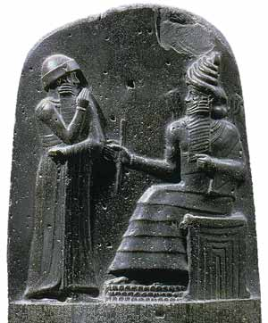
Sample Multiple Choice Q’s
Questions 1–3 refer to the image below.
Basalt stela showing King Hammurabi of Babylon (circa 1750 b.c.e.) on the left and the sun god
Shamash on the right. The Code of Hammurabi is inscribed at the bottom of the stela.

Slide 20
1. The relationship between Hammurabi and Shamash as depicted in the image best illustrates which of the following features of ancient civilizations?
(A) Rulers deferred to the priestly class for religious guidance.
(B) Rulers asserted that royal laws were superior to divine laws.
(C) Rulers created new religions to unify conquered peoples.
(D) Rulers claimed that their authority derived directly from divine power

Slide 21
2. In addition to commissioning the creation of objects such as the one shown in the image, rulers of early civilizations most commonly used which of the following activities to demonstrate their religious authority?
(A) The creation of systems of record keeping
(B) The creation of epic mythologies
(C) The construction of water-control systems
(D) The construction of monumental architecture

Slide 22
3. Which of the following best describes the significance of legal codes to early civilizations?
(A) They granted citizens the right to choose their rulers and representatives.
(B) They reflected and reinforced existing social and political hierarchies.
(C) They facilitated the introduction of monotheistic religions.
(D) They effectively settled disputes between pastoralist and agrarian communities.

Slide 23
Answers
1. D
2. D
3. B

Slide 24
Short Answer Question (SAQ)
4 Questions
50 Minutes
20% of score

Slide 25
SAQ
Will require students to use historical thinking skills to respond to a primary source, a historian’s argument, nontextual sources such as data or maps, or general propositions about world history.

Slide 26
What should I know about the Short Answer Question (SAQ) portion of the exam?
There are 4 SAQs following the MC section.
You will 50 minutes to complete your SAQ responses.
SAQs have multiple questions, typically 2-3 sub questions.
SAQ prompts are typically paired with a stimulus—e.g. an image, chart, map, document passage, etc.
Each sub-question is worth 1 point.

Slide 27
How do I answer an SAQ?
Always in complete sentences, and labeled with the question number and sub-question letter.
Identify the verb in the question.
Identify the HTS in the prompt.
Answer all parts of the prompt directly, and with specific historical evidence (SHE).
Explain your answer's relevance to the prompt/HTS.
Stick with the following format!
Answer and explain. You must do both to earn the point.

Slide 28
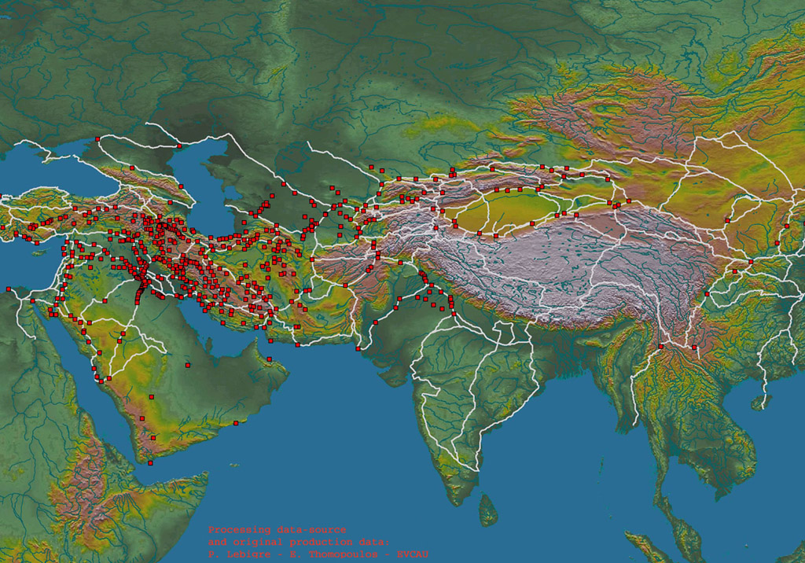
Sample SAQ
LOCATIONS OF RUINS OF CARAVANSERAI(LODGING STATIONS FOR MERCHANTS) IN EURASIA

Slide 29
Sample SAQ
a) Identify and explain TWO factors before 1450 c.e. that account for the pattern of the caravanserai shown on the map.
b) Identify and explain ONE reason that the caravanserai shown on the map declined in significance in the period 1450–1750 c.e.

Slide 30
Sample SAQ Answer
A good response will provide and explain two factors that account for the spatial patterns of the spread of the caravanserai before 1450 C.E. Such factors might include the improved transportation technologies and commercial practices that led to an increased volume and geographic expansion of trade, as well as the expansion of empires, such as the caliphates and the Mongols, that facilitated Eurasian trade and drew new peoples and places into trade networks. A good response must also briefly explain the decline of these overland trade routes after 1450 C.E. due to, for example, the growing volume of maritime trade facilitated by European traders and joint-stock companies that used American silver to purchase Asian goods.

Slide 31
The Document Based Question

Slide 32
The Goal
To organize multiple documents into an essay that addresses all parts of the question
Simple....
Right?

Slide 33
The Rubric
Thesis and Argument Development (2 Points)
Document Analysis (2 Points)
Using Evidence Beyond the Documents (2 Points)
Synthesis (1 Point)
Total Points Possible = 7

Slide 34
Hints
When the readers score essays, they start at zero and add points as the point are EARNED
All essays can earn up to 7 points if all elements are there

Slide 35
Thesis (1 point)
Presents a thesis that is historically defensible and responds to all parts of the question.
The thesis must consist of one or more consecutive sentences located either in the introduction or conclusion paragraph.
Should be comprised of "Rule of 3" argumentative points.

Slide 36
Argument Development (1 point)
Develops and supports a cohesive argument that recognizes and accounts for complexity by explicitly illustrating relationships among the historical document evidence.
Relationships such as contradiction, corroboration, and/or qualification.
These relationships should be cohesive and well-explained consistently throughout the essay.

Slide 37
Document Analysis: Content(1 point)
Uses the content of at all the documents to support the stated thesis.
All evidence provided must be explained and linked as support for the stated thesis.

Slide 38
Document Analysis: Analysis(1 point)
Explains the significance of the author's POV, purpose, historical context, and/or audience for at least 6 of the documents.
To analyze is to: 1) Explain why a document "says" what it "says" and 2) To elaborate on how this is significant in terms of the information conveyed in the document; i.e. how it shapes or informs what is expressed in the document.

Slide 39
Using Evidence: Contextualization(1 point)
Provides a setting for your thesis argument by explaining the global historical events, developments, or processes that are immediately relevant to the prompt.
Another term for this is World Historical Context (WHC)
Include this in your introduction paragraph before your thesis.

Slide 40
Evidence Beyond the Documents (1 point)
Provides an example or additional piece of specific historical evidence beyond those found in the documents to support or qualify the argument.
This may be included anywhere in the body section of your essay. It should support your discussion of a particular document.

Slide 41
Synthesis (1 pt)
Extends the argument of the essay by explaining the connections between the argument and ONE of the following:
A development in a different historical period, situation, era, or geographical region.
A course theme and/or approach to history that is not the focus of the essay.
A different discipline or field of inquiry (e.g. economics, government and politics, art history, or anthropology)
Only one synthesis statement is required, and it should appear in your conclusion paragraph.

Slide 42
Proofread your work!
If you have time at the end make sure to re-read your essays
Make sure you have included all required information!

Slide 43
Long-Essay Question (LEQ)

Slide 44
The Rubric
Acceptable Thesis – 1 point possible
Argument Development using the Targeted Historical Thinking Skill – 2 Points Possible
Argument Development using Evidence – 2 Points Possible
Synthesis – 1 Point Possible

Slide 45
Hints
When the readers score essays, they start at zero and add points as the point are EARNED
All essays can earn up to 7 points if all elements are there
Answer ALL parts of the question!!!!

Slide 46
Acceptable Thesis (1 point)
Presents a thesis that is historically defensible and responds to all parts of the question.
The thesis must consist of one or more consecutive sentences located either in the introduction or conclusion paragraph.
Should be comprised of "Rule of 3" argumentative points.

Slide 47
Argumentation: Targeted HTS (2 points)
(Only one of the four HTS will be targeted on the LEQ portion of the exam)
Observe "Rule of 3" in all HTS cases.

Slide 48
COMPARISON Develops and supports an argument that…
1 PT: Describe sims AND diffs among historical individuals, events, developments, or processes.
1 PT: Explains the reason for sims AND diffs
OR, depending on the prompt: evaluates the significance of historical individuals, events, developments, or processes.

Slide 49
CAUSATION Develops and supports an argument that…
1 PT: Describes causes AND/OR effects of a historical event, development, or process.
1 PT: Explains the reasons for the causes AND/OR effects of a historical event, development, or process.

Slide 50
CCOT Develops and supports an argument that…
1 PT: Describes historical continuity AND change over time.
1 PT: Explains the reason for historical change AND continuity over time.

Slide 51
PERIODIZATION Develops and supports an argument that…
1 PT: Describes the ways in which the historical development specified in the prompt was different from and similar to developments that preceded AND/OR followed.
1 PT: Explains the extent to which the historical development specified in the prompt was different from and similar to developments that preceded AND/OR followed.Include a counter argument.

Slide 52
Argumentation: Using Evidence (2 Pts)
1 PT: Addresses the topic of the prompt with at least "Rule of 3" pieces of relevant Specific Historical Evidence (SHE).
1 PT: Links the "Rule of 3" specific historical evidence provided to fully and effectively support the stated thesis or a relevant argument.

Slide 53
Synthesis: 1 Point
Extends the argument of the essay by explaining the connections between the argument and ONE of the following:
A development in a different historical period, situation, era, or geographical region.
A course theme and/or approach to history that is not the focus of the essay.
A different discipline or field of inquiry (e.g. economics, government and politics, art history, or anthropology)
Only one synthesis statement is required, and it should appear in your conclusion paragraph.

Slide 54
Proofread your work!
If you have time at the end make sure to re-read your essays
Make sure you have included all required information!

Slide 55
Sample LEQ’s (Choose 1 of 2)
Question 2:
Evaluate the extent to which the emergence of Buddhism in the fifth century b.c.e. can be considered a turning point in world history.
In the development of your argument, explain what changed and what stayed the same from the period before the emergence of Buddhism in the fifth century b.c.e to the period after the emergence of Buddhism in the fifth century b.c.e (Historical thinking skill: Periodization).
Question 3:
Analyze the political, economic and social causes of the fall of the Roman and Han Empires. (Historical thinking skill: Causes).

